Slide 1




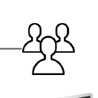
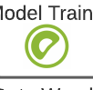
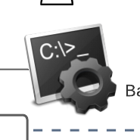
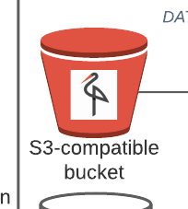

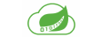
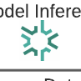
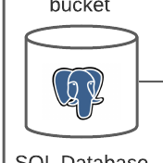
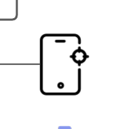
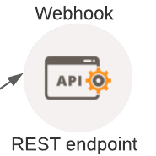

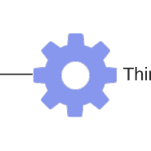
Data Visualization
Monitoring
CRM
Exploratory Data Analysis
Ad-hoc
Reporting
ERP
Security
App users
Batch Reporting
Batch jobs
Automation
S3 compatible
bucket
Data Ingestion
Data Processing
Model Training
Model Validation
Model Deployment
SQL Database
Data
Governance
IoT Devices
Webhook
Third-party Services
Message Broker
Data
Management
REST endpoint
Data Engineering
Data Analytics | Data Science | Software Engineering
DataOps | MLOps

Slide 2
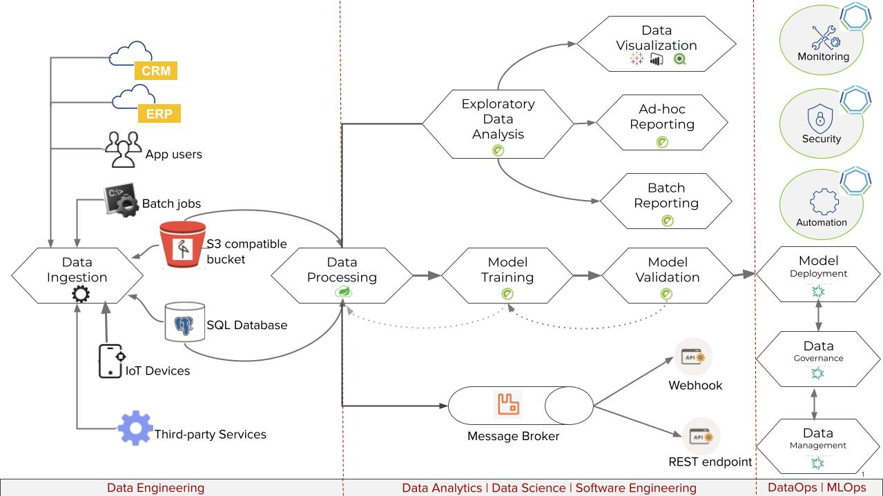
End-to-end Data Lifecycle

